Slide 1
GAM2003 Project Presentation
Game Name: Wormhole
Engine: Unity
IP: Eve Online
Jonathan Ogilvie
Jonathan Cohen
Richard Koys
Alejandro Baeza Alvarez
Notes:
Add Fig Numbers once done

Slide 2
Game Overview
High Concept
  Wormhole is a Sci-FI experience set on a space station that incorporates a mixture of stealth and strategy into one, unique experience. Avoid getting caught as you sabotage system facilities and escape with your evidence.
Themes
  Multiple themes each centred around different task types;
    Residential
    Industrial
    Communications / Control
    Engine / Fuel
Narrative
  Multiple Endings
  Player is on board enemy space station and has to collect information while concealing their true identity
Design Pillars & USPs
  Tasks are performed in unique, engaging ways
  Sabotaging Systems, Collecting Information
  Stealth and Strategy
  Unique Level Design

Slide 3
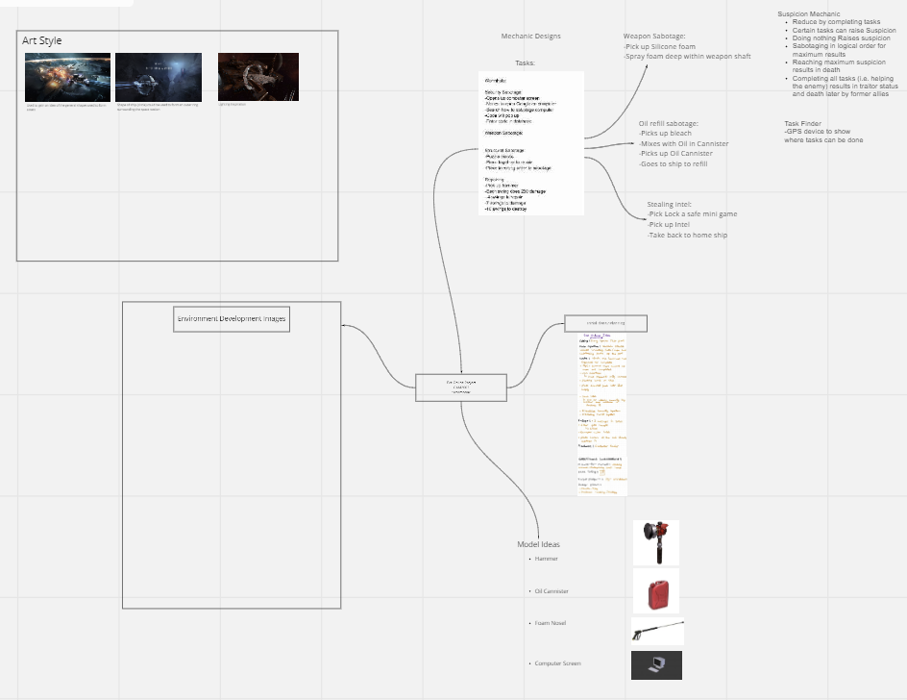

Constraints
Out-game constraints:
    Organization.
    Brainstorming.
[Figure 1 - Discord Logo]
[Figure 2 - Mechanic Planning / Development]

Slide 4
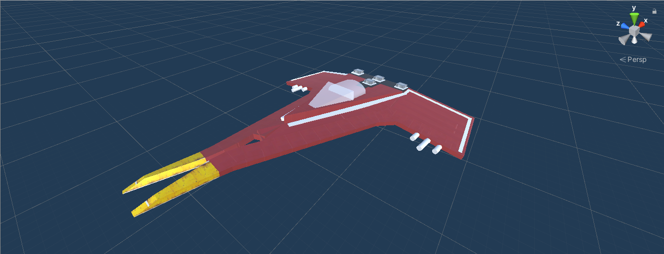
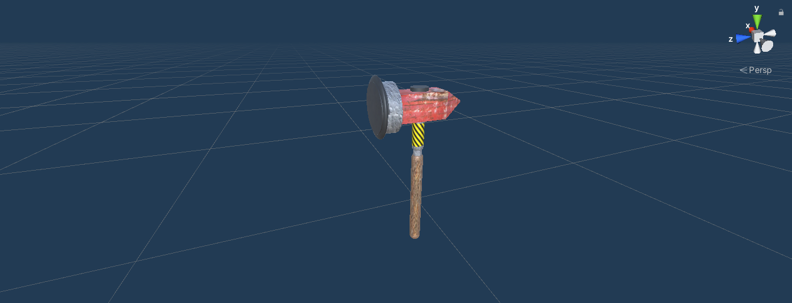
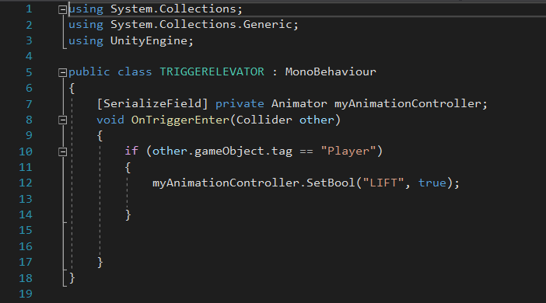
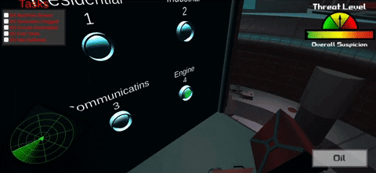
Constraints
In-game constraints:
    Creative: Shapes, 3D models, coding and animations.
    I.P. related: World constraints.
[Figure 3 - Modelled Spaceship]
[Figure 4 - Modelled Hammer]
[Figure 5 - Script Example]
[Figure 6 - Elevator Issue]

Slide 5

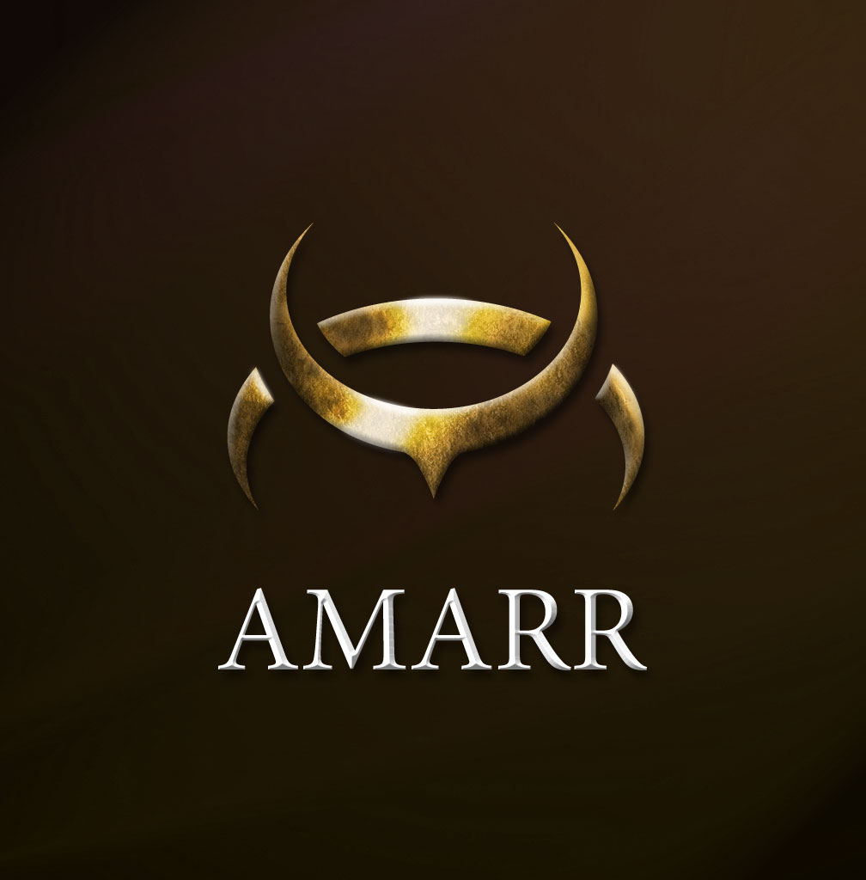
Guristas Pirates Vs Amarr Empire
Complete all the tasks on the checklist
Radio Communication
Imperfect Information
Guristas Pirates
  A group of Ex-Navy Officers who are a thorn to the Caldari state, as well as kidnappers and thieves who steal for themselves.
Amarr Empire
  A race while peaceful is filled with people who have a perfection-complex. Believing they are the chosen people and so on.
[Figure 7 - Guristas Pirates Logo]
[Figure 8 - Amarr Empire Logo]

Slide 6
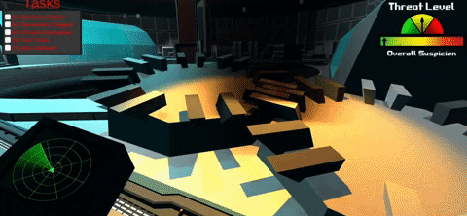
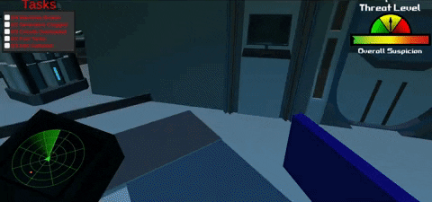
Physical Tasks and Interactive Tasks
[Figure 9 - Hammer Demonstration in Game]
[Figure 10 - Card Swipe Task in Game]

Slide 7
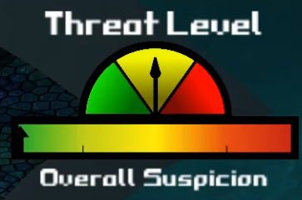
Repair and Sabotage
Sabotage Will Increase Suspicion
Repairing Will Lower the Suspicion
[Figure 11 - Threat / Suspicion Meter]

Slide 8
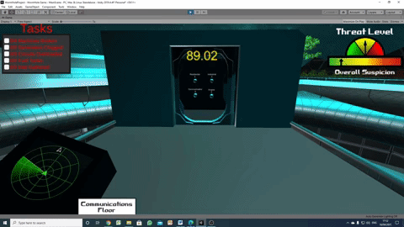
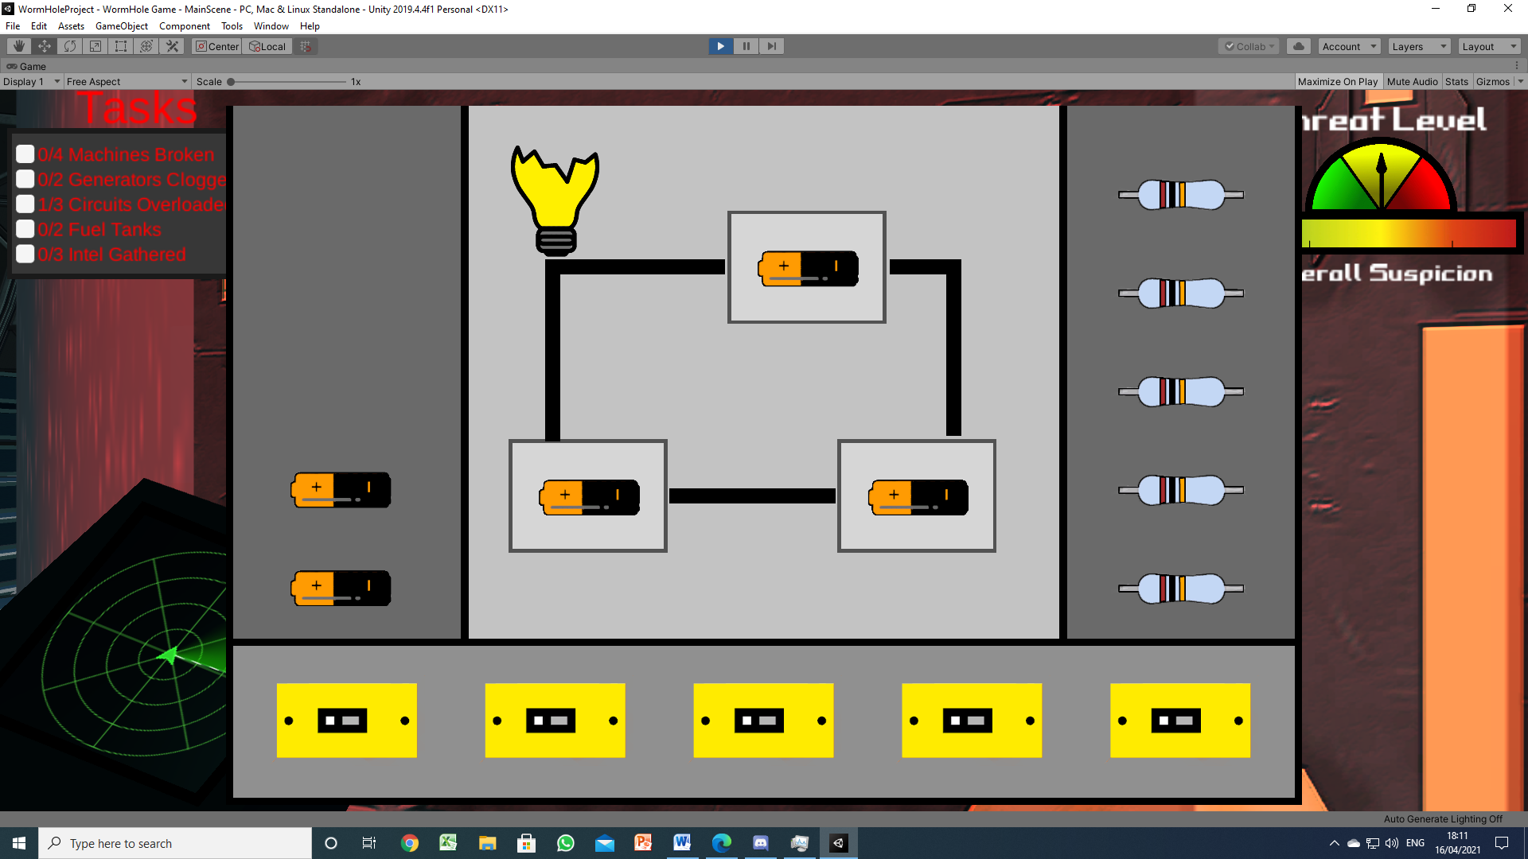
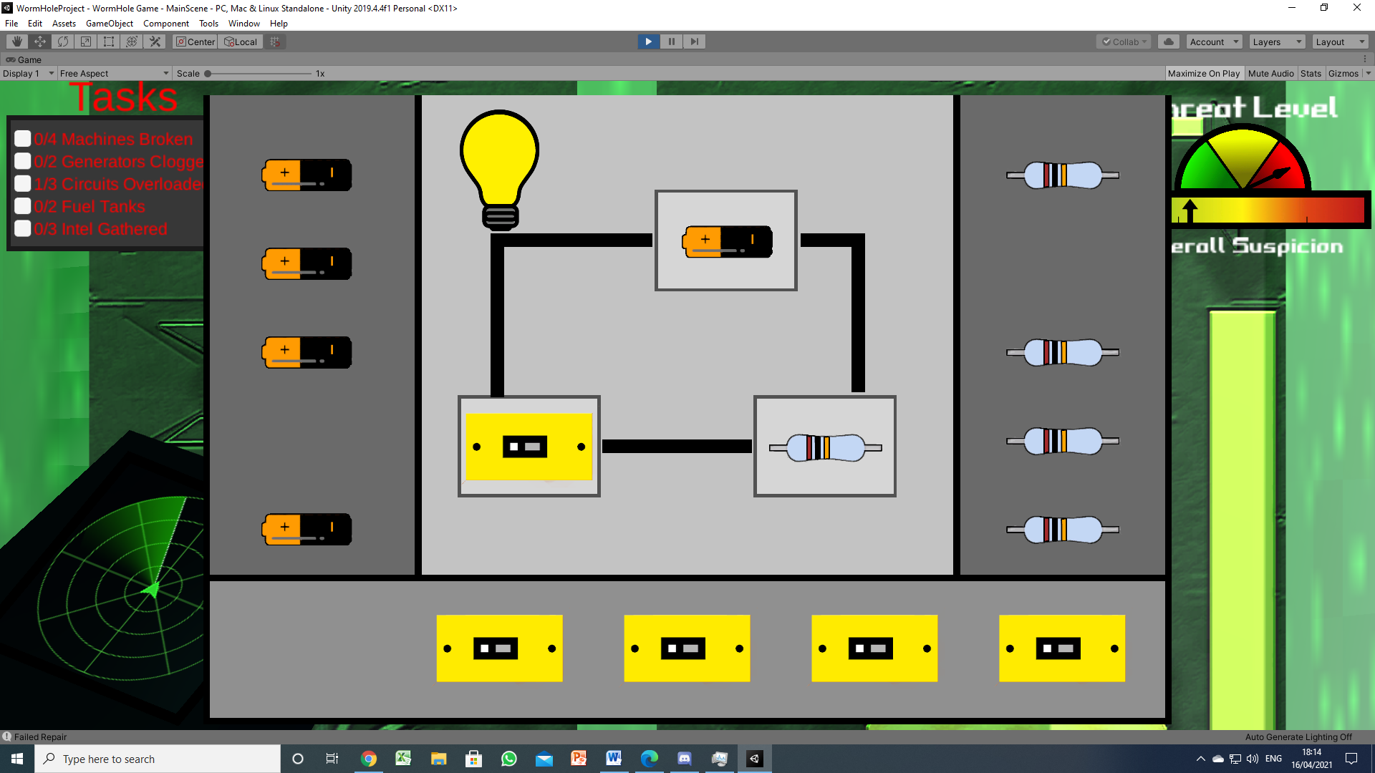
Other Features
Not Doing anything for 90s
Not Repairing for 45s
Events
Radar
[Figure 12 - Lighting Task (Sabotaged)]
[Figure 14 - Timed Event Example (UI)]
[Figure 13 - Lighting Task (Complete)]
“A good gamemaster will sense when his players are getting bored, and give them something to do.” + “its because the design isn’t supporting an adequate diversity of goals – simply slaying monsters and taking their treasure does pall after a time” (Greg Costikyan 2002)

Slide 9
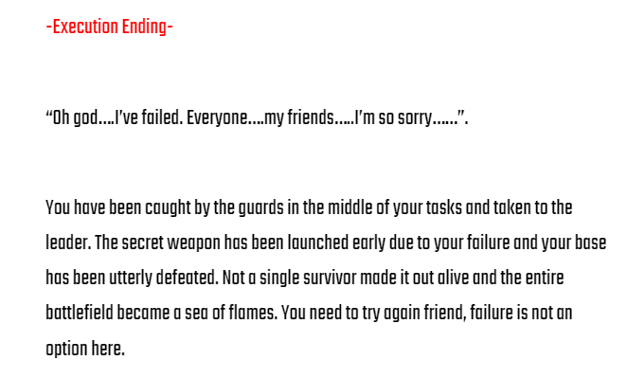
Multiple Endings
Congratulatory Ending
Unsatisfactory Ending
Execution Ending
Traitor Ending
[Figure 15 - Execution Ending Narrative]
For the player “to agree to behave as if achieving victory is important” (Greg Costikyan 2002)

Slide 10
Narrative
Reasons for the Chosen Factions:
  Guristas Pirates: Villainous, Antagonistic, Rebellious
  Amarr Empire: Self-Righteous, Peaceful, Have a perfection-complex
Classic Infiltration Missions:
  Invading the opposing enemy’s base or any other sector to gain intel
  Plot Twisting Game (Not what it seems)
  Hidden realizations (In game hints)
Chosen Tone for the Assistant
  Low and slightly pushy (not too rude)
  Experienced and Informed.
[Figure 16 - Guristas Pirates Logo]
[Figure 17 - Amarr Empire Logo]

Slide 11
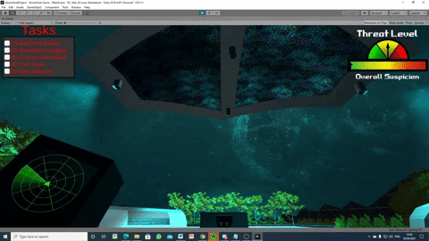
Iteration
Events,Text To Speech, Elevator
Particle Effects, Moving Doors, Spaceships
[Figure 18 - Flying Ships Around Environment]
“If all polish were removed…the player would find the experience less perceptually convincing and therefore less appealing”(Swink 2009)

Slide 12
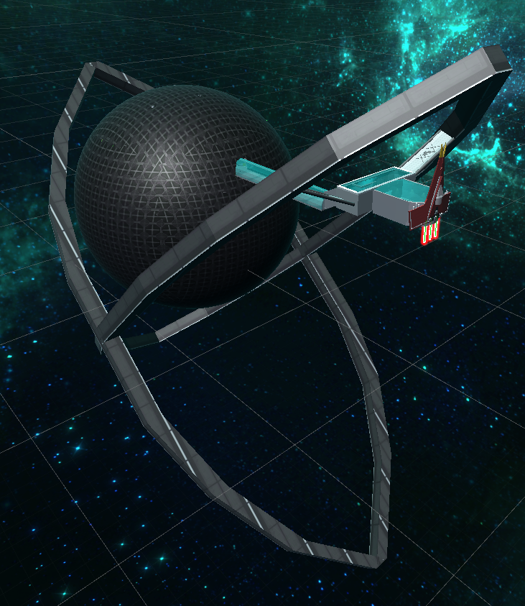
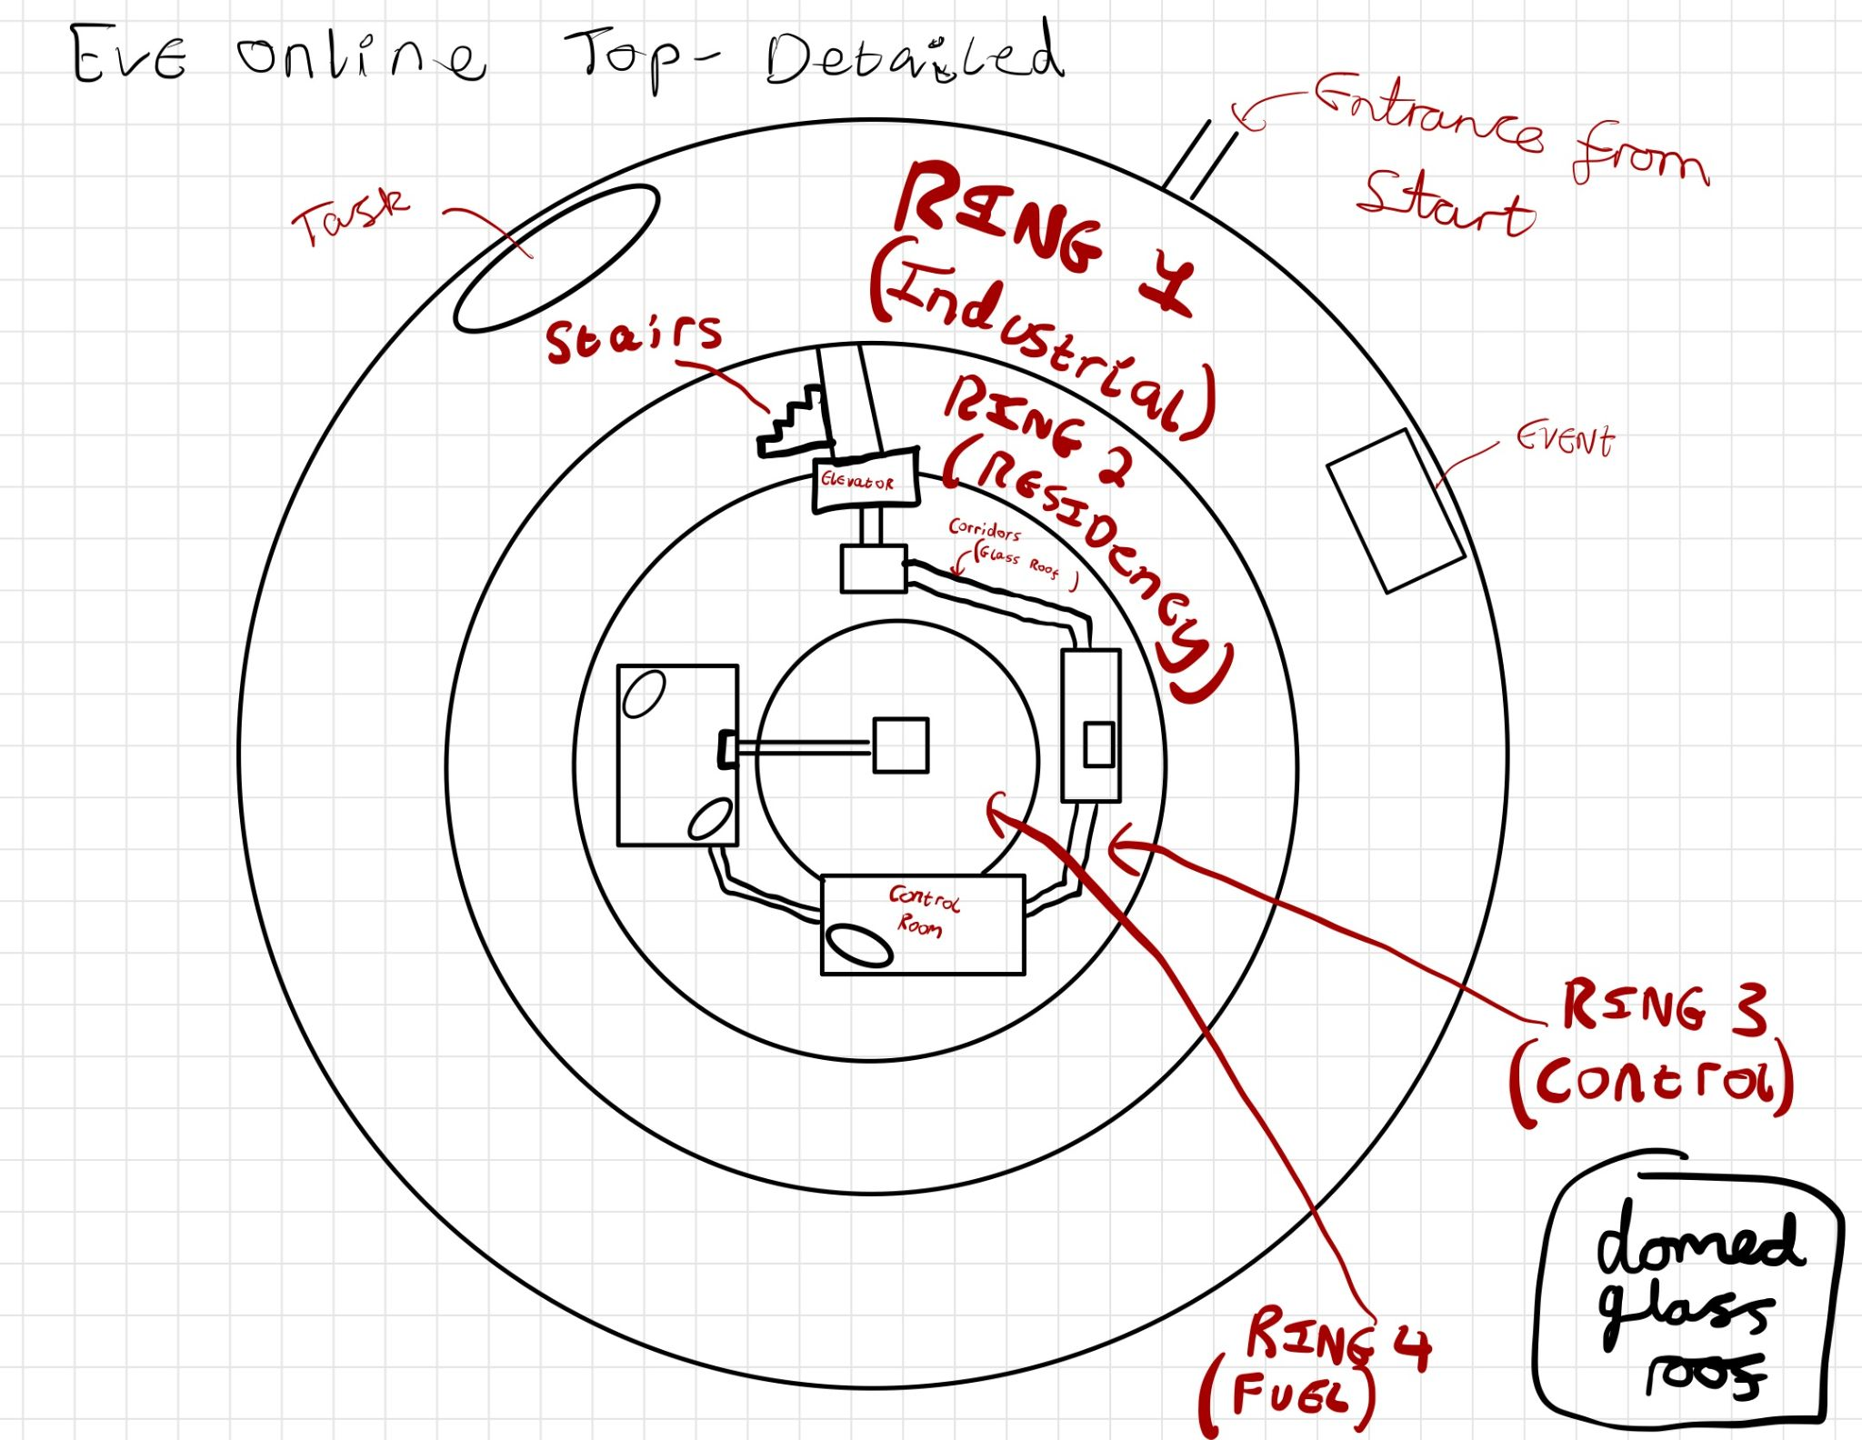
Environment Design (Outline)
Based on a circular promenade.
  4 Levels in total
  Each level has a different theme with different activities
Player begins in a separate room
  Eventually enters the main promenade area
Outer Structure Support
  Two rings hold the station together
    Inspired by Eve Online ship design
[Figure 19 - World Environment Whole View]
[Figure 20 - Environment Main Area Planning]

Slide 13
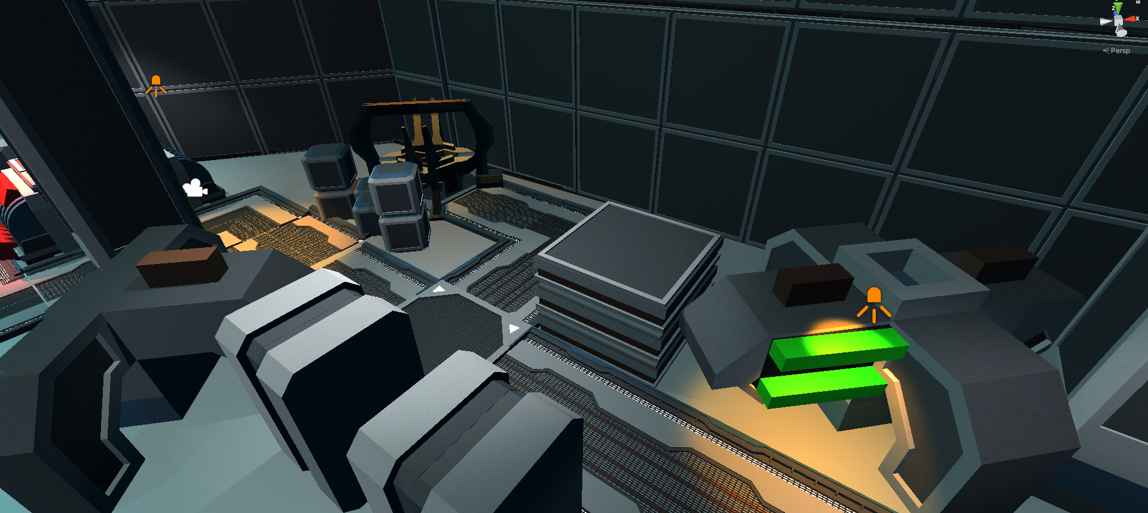
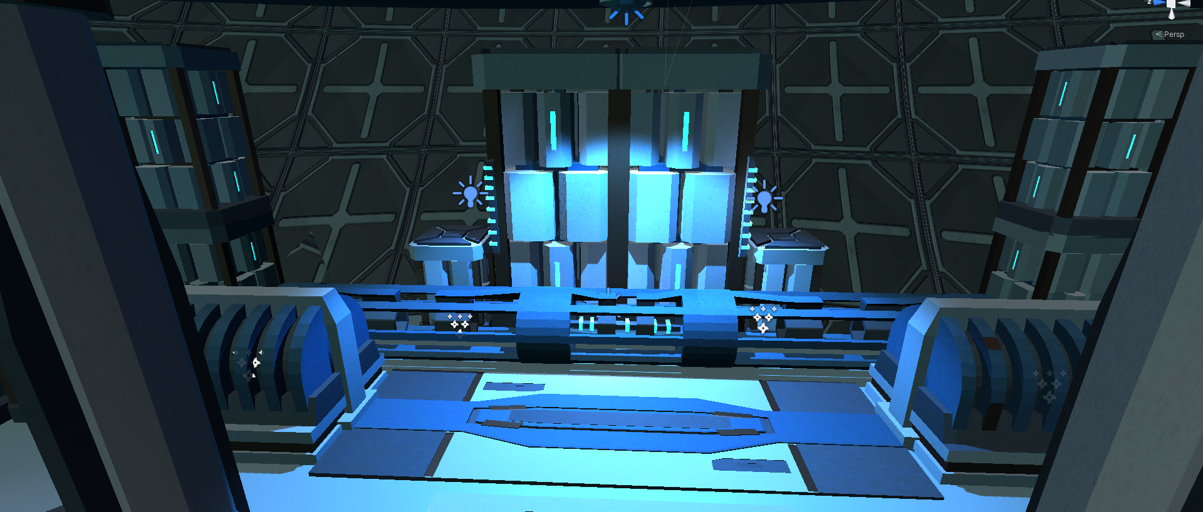
Environment Interior + link to IP
Different design for each floor
Sci-Fi Asset package
Connection to IP
Judgement day
[Figure 21 - Industrial Interior Design ]
[Figure 22 - Engine Interior Design ]

Slide 14
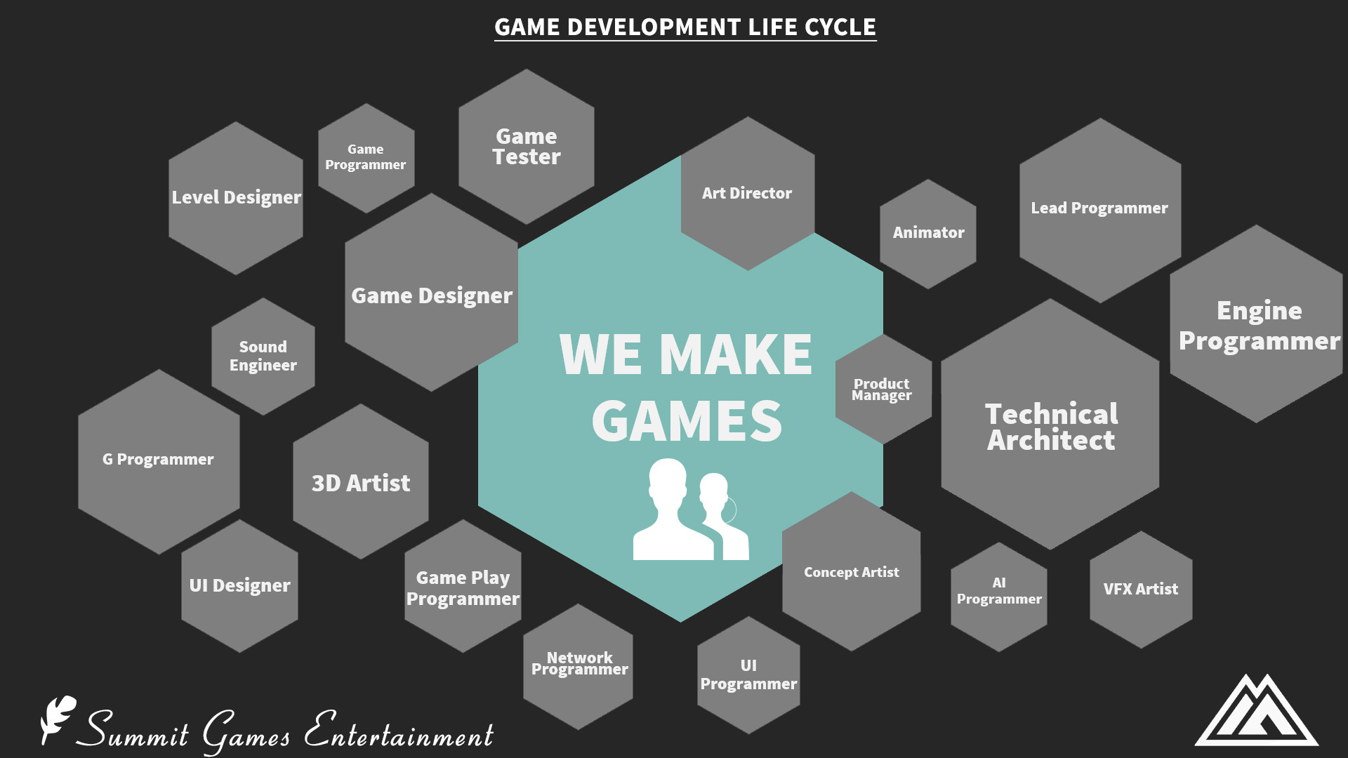
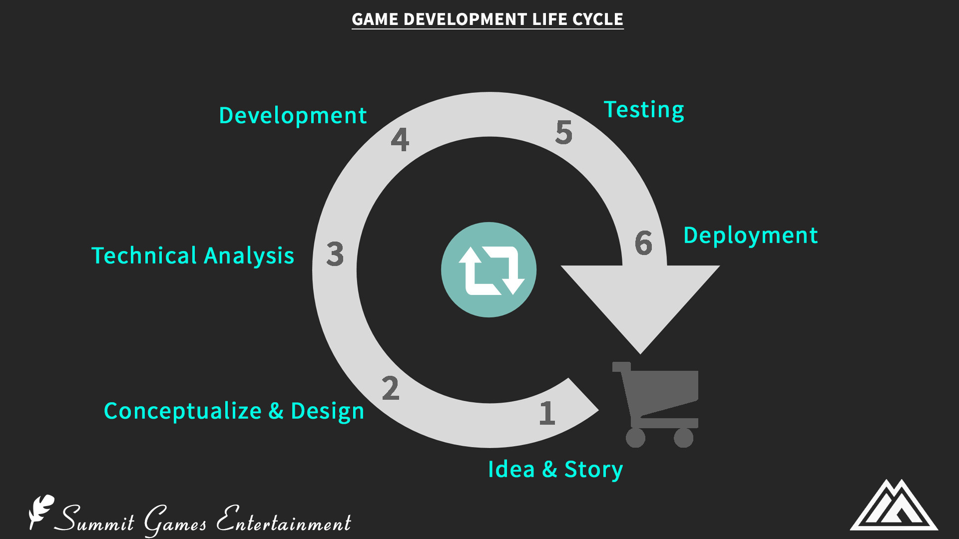

Project Management
Discord:
  When we started the project we made our group team on Discord to have our team meetings, discuss our roles, and plan on deadlines for our work.
  We have used Trello to create our plan board,Google Docs to upload our work for everyone to see, and used Unity to create the entire game itself while following the game Development Life Cycle.
  We chose to go with the Agile methodology is a type of project management process used for software development Pros: Quick development (Prototyping). Cons: If one person changes one thing, everyone needs to change something as well.
[Figure 23 - Game Development Life Cycle Inspiration Board]
[Figure 24 - Game Development Life Cycle]
[Figure 25 - Discord Logo]

Slide 15
References
. Costikyan, G (2002) "I Have No Words, and I Must Design: Toward a Critical Vocabulary for Games."
· Mitchell, K (2018) Discord Heads To The Xbox One [Online] Available at: https://www.theouterhaven.net/2018/04/discord-heads-to-the-xbox-one/
· Sumit, J. (2017) Game Development Life Cycle [Online] Available at: https://www.linkedin.com/pulse/game-development-life-cycle-sumit-jain
. Swink, S. (2009) Game Feel, Morgan Kaufman
· Uniwiki (2021) Factions [Online] Available at: https://wiki.eveuniversity.org/Factions

